Slide 1

Customer Segments Preliminary Modeling Result and Discussion
03/08/22
by: Zubin Moosa, Xingkai Wu, Alison Guo, Sena Peng

Slide 2
Model #1
Utilizes banking & demographic info to predict whether user is Heavy Cash/Credit/Debit
Sample size: 7328
Tool: Python
Method: XGBoost
Variables
User_Visible_Minority
User_Smartphone_Usage
User_Debit_Tap_Availability
User_Age
User_Income
User_Gender
User_Region
User_Education
User_Lifestage
User_Immigrant_Status
User_Payment_Preference
User_Banking_Package
User_Main_Bank
User_Main_Debit_Card
User_Main_Credit_Card

Slide 3
Segment Collapsing
Before
After
Heavy Credit
The Achiever
The Maximizer
Heavy Debit
Heavy Cash
The Collector
The On-the-Goer
The Safekeeper
The Budgeter
The Traditionalist

Slide 4
Data Splitting
* 2019-2020 Payment Diary Data at customer level

Slide 5



Model 1A XGBoost Result (without User Payment Preference)
Notes:
XGBoost applies level-wise tree growth where LightGBM applies leaf-wise tree growth. Level-wise approach grows horizontal whereas leaf-wise grows vertical.

Slide 6
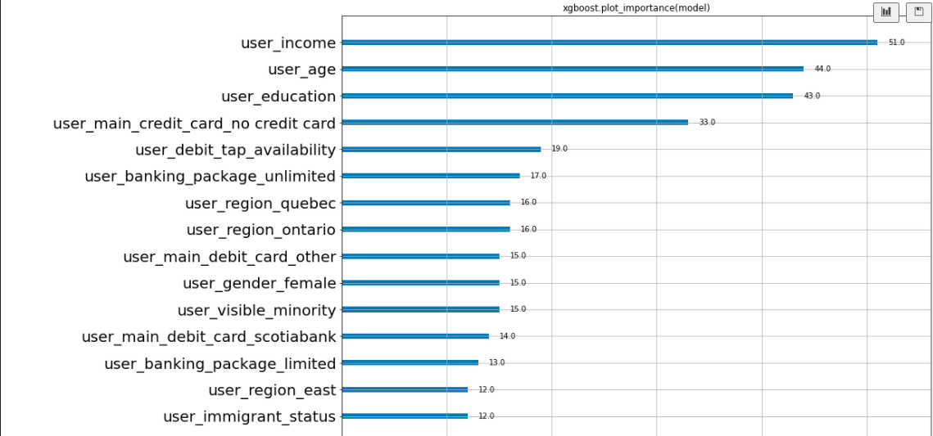
Model 1A Feature Importance (without User Payment Preference)
Notes:
Histogram-based gradient boosting is a technique for training faster decision trees used in the gradient boosting ensemble

Slide 7

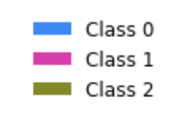
Model 1A SHAP Values (without User Payment Preference)
“no credit card” = 0 → Credit Class
“unlimited banking package” → Debit Class
Notes:
Histogram-based gradient boosting is a technique for training faster decision trees used in the gradient boosting ensemble

Slide 8
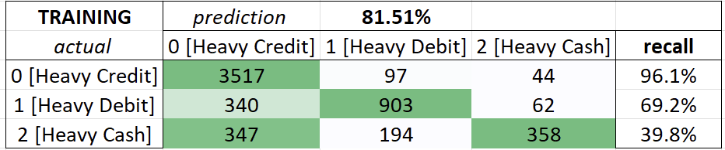
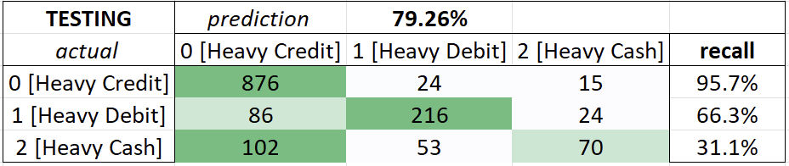
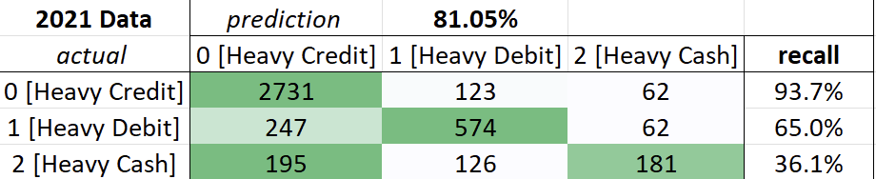
Model 1B: XGBoost Result (with User Payment Preference)
+1%
+34%
+26%
-2.3%
+51%
+30%
Notes:
Histogram-based gradient boosting is a technique for training faster decision trees used in the gradient boosting ensemble

Slide 9
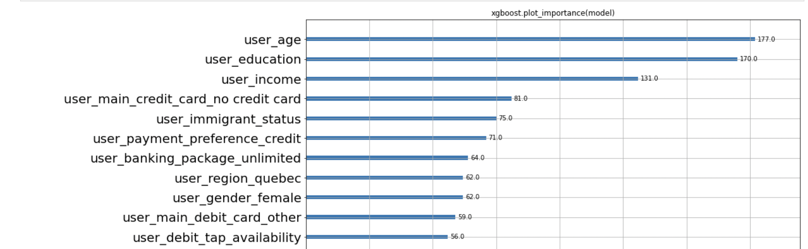
Model 1B Feature Importance (with User Payment Preference)
Notes:
Histogram-based gradient boosting is a technique for training faster decision trees used in the gradient boosting ensemble

Slide 10

Model 1B SHAP Values (with User Payment Preference)
Payment preferences are powerful indicators to properly segment users
“Prefer Credit” → Credit Class
“Prefer Debit” → Debit Class
“Prefer Cash” → Cash Class
Notes:
Histogram-based gradient boosting is a technique for training faster decision trees used in the gradient boosting ensemble

Slide 11
Model #2 – 2021 prediction In Progress
Utilizes only debit transaction data to predict whether user is Heavy Cash/Credit/Debit
Sample size: 7328
Tool: Python
Method: XGBoost
Variables
User_Debit_Tap_Availability
User_Region
User_Banking_Package
User_Main_Bank
User_Main_Debit_Card

Slide 12


Model 2: XGBoost Result
Notes:
Histogram-based gradient boosting is a technique for training faster decision trees used in the gradient boosting ensemble

Slide 13
Variable Reduction(RFECV)
104 Variables*
44 Variables*
* Including dummy variables

Slide 14
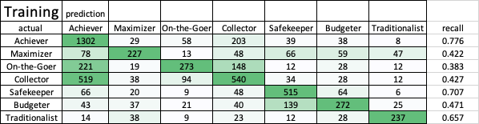
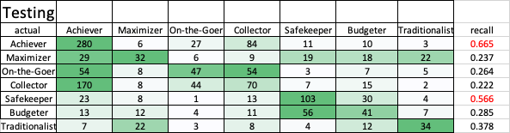
HistGradientBoosting Result(w/o transaction data)

Slide 15
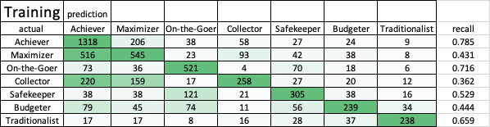
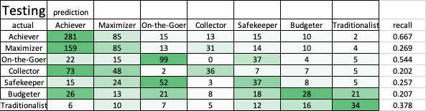
XGBoost Result(w/o transaction data)

Slide 16
Variable Reduction(RFECV)
73 Variables*
53 Variables*
* Including dummy variables

Slide 17
Next Steps
Hist
Gradient
Boost
XG
Boost
Stacked Model

Slide 18
Thank You

